Slide 1
Netflix Recommend System
Design document

Slide 2
Hadoop Enviroment
Run first before we start
Show the test data
Run the mapreduce

Slide 3
Project Background
The Netflix recommender system is a famous system that Netflix provided $1M in 2009 to support the challenge to improve the accuracy of prediction about how much someone is going to enjoy a movie based on their movie preferences.
100 million ratings from 480 thousand randomly-chosen, anonymous Netflix customers
Over 17 thousand movie titles. The data were collected between October, 1998 and December,
The ratings are on a scale from 1 to 5 (integral) stars. T
details information, visit below links:
http://netflixprize.com/
https://gist.github.com/janisozaur/3192952
http://academictorrents.com/details/9b13183dc4d60676b773c9e2cd6de5e5542cee9a

Slide 4
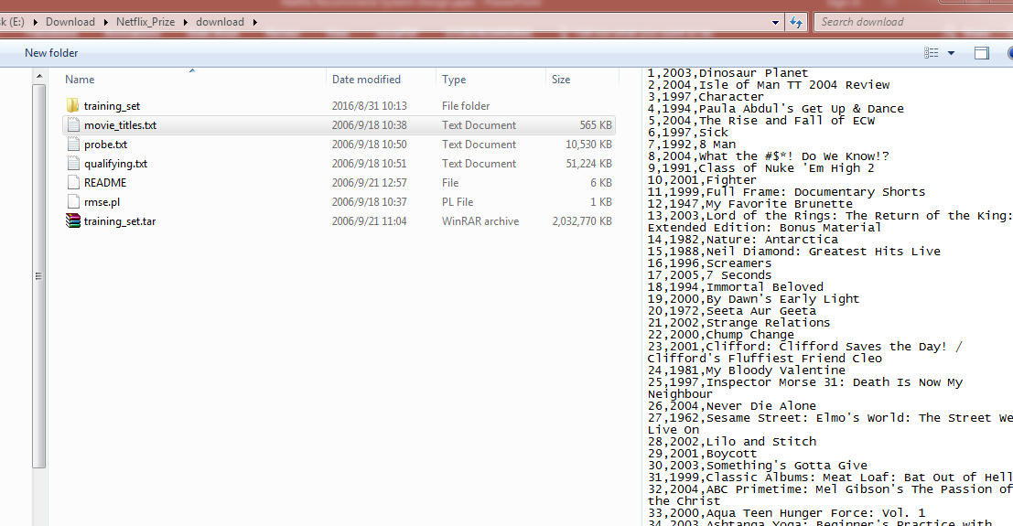

Slide 5
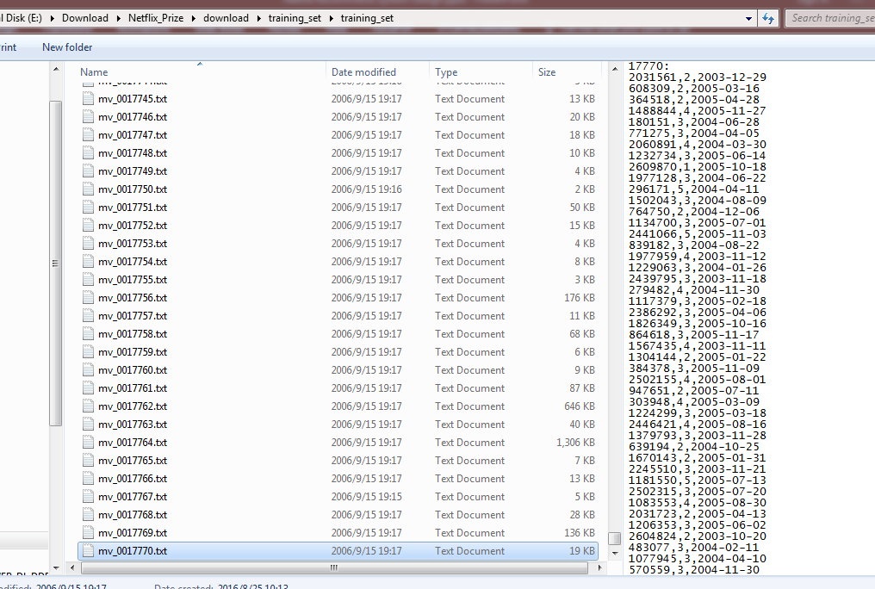

Slide 6
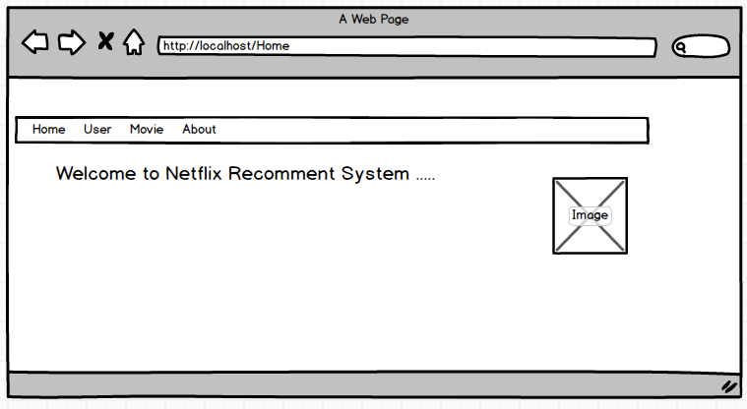
UI Design – HomePage

Slide 7
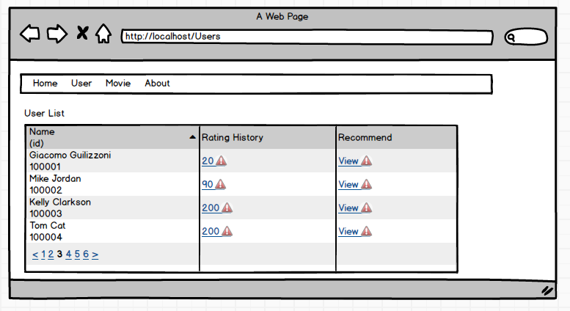
User List

Slide 8
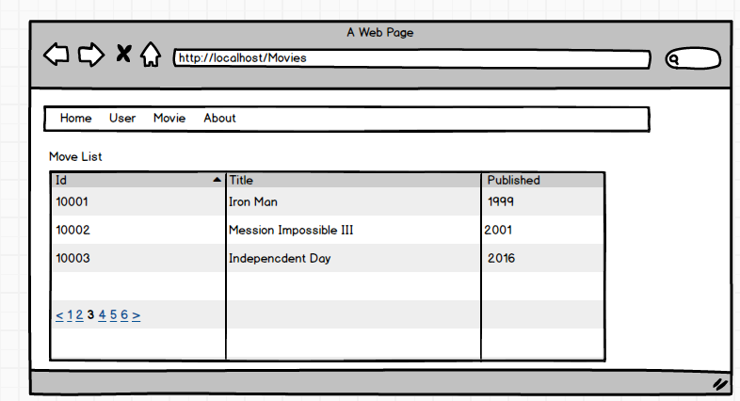
Movie List

Slide 9
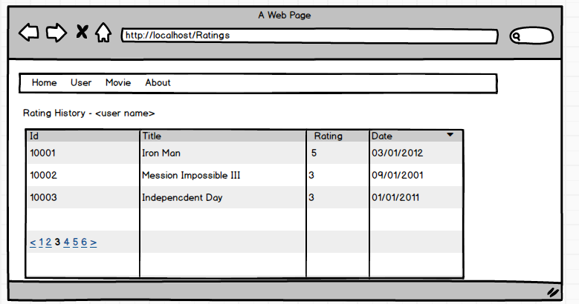
User Rating List

Slide 10
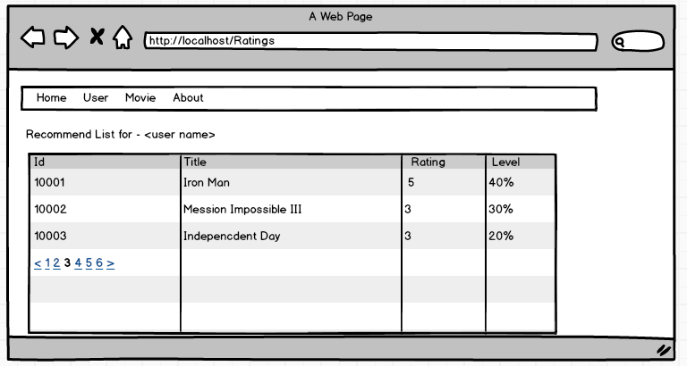
Recommand List

Slide 11
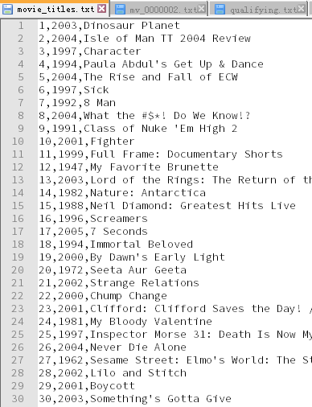

Database Design

Slide 12
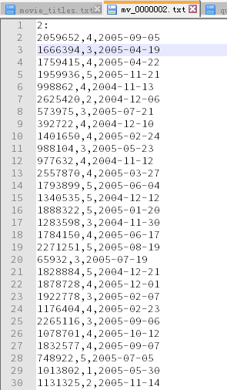
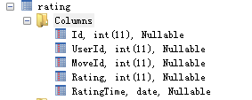

Slide 13
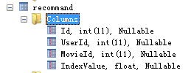
Import from Hadoop
userId movieId IndexValue
2059652 2 0.45
2059652 5 0.35
2059652 1 0.06
2059652 20 0.03

Slide 14

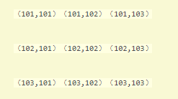

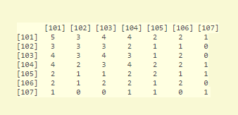
Algorithm Design
Notes:
1. 针对用户 1 对电影101 102 103 进行了评分，那么会在上述的矩阵如下位置写 1 ：
（101,101）（101,102）（101,103）
（102,101）（102,102）（102,103）
（103,101）（103,102）（103,103）
即对101,102,103进行组合产生3*3个位置点，在对应的位置写1就行。
2. 针对所有的用户进行上述操作，然后将所有的结果相加，最后就可以得到同现矩阵。

Slide 15

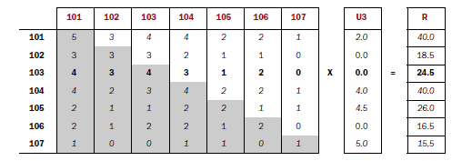
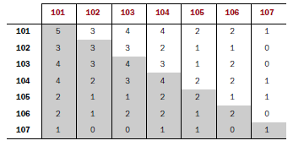
Algorithm Design
Co-occurrence Matrix (https://en.wikipedia.org/wiki/Co-occurrence_matrix)

Slide 16

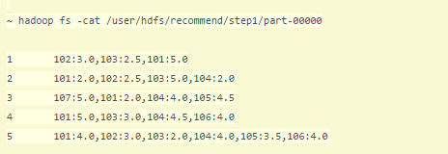
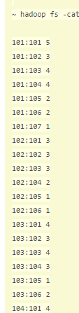
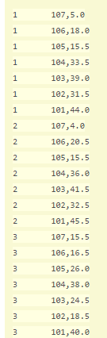
MapReduce Step

Slide 17
Demo

Slide 18
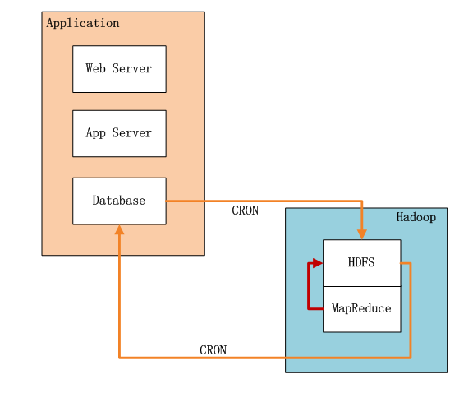
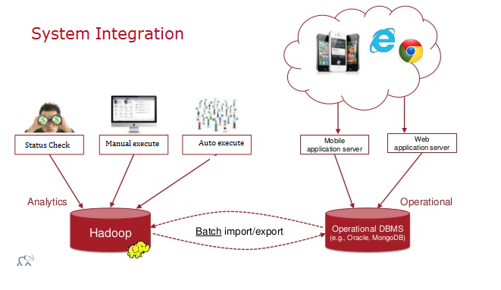
System Design

Slide 19
Others
Java
MapReduce
Tomcat
Spring MVC
Logging

Slide 20
Thank you !

